Slide 1

MAKE IN INDIA
IT ENTREPRENEURSHIP
By Manas Pattnaik
7th April 2015

Slide 2

MAKE IN INDIA
AN INITITATIVE OF GOI
MORE JOBS TO BE DONE IN INDIA
GENERATE EMPLOYMENT
MORE EXPORT & LESS IMPORT
SAVE FOREIGN EXCHANGE
GROWTH OF GDP & PER CAPITA INCOME
ENTREPRENEURSHIP DEVELOPMENT
7th April 2015

Slide 3
IT & BPO SECTOR(H/W)
DEVICES : PC,Tabs, Mobiles & Smart Devices
COMPONENT : Chips, PCBs & DISKs etc.
DESIGN
R&D
7th April 2015

Slide 4
IT & BPO SECTOR(S/W & SERVICES)
APPLICATION : Product, Project
SYSTEM : OS for devices
TOOLS : CAD/CAM, SE Tools, Searching Tool & Cloud etc.
BPO/KPO : Call Centre
DIGITIZATION : Scanning
MAINTENANCE : H/W, S/W
RE ENGINERING SERVICES : EWASTE
7th April 2015

Slide 5
IT & BPO SECTOR(DATA COMM)
EXCHANGE : Data, Voice
NOC : Satelite, Fibre & Radio
WSN : Smart City, Defence & Weather
NETWORKING : Mobile & Internet
7th April 2015

Slide 6
INDIAN STORY OF IT
Past 3 Decades:1980-1990
Onsite Development
Hardware Import
Introduction of Internet
Specialized Training
Export Market
7th April 2015

Slide 7

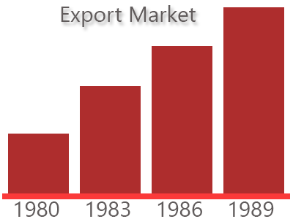

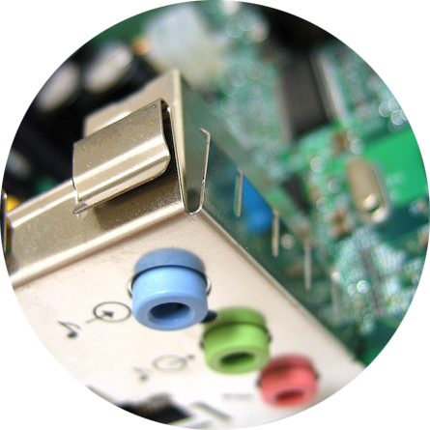

7th April 2015

Slide 8
INDIAN STORY OF IT
Past 3 Decades:1990-2000
Offshore Development
Assembling
Applications on Internet
Improved Processes
Domestic Sector
7th April 2015

Slide 9
INDIAN STORY OF IT
Past 3 Decades:2000-2010
Offshore & BPO
Designing & Manufacturing Centre
Fast Internet
Packaging
Global Market
7th April 2015

Slide 10
INDIAN STORY OF IT
Current Trends of IT
Mobile Applications
Internet Everywhere
Smart Devices / Tablets
Cloud Computing
Big Data
Better ICT infrastructure / Security
7th April 2015

Slide 11
INDIAN STORY OF IT
Current Applications of IT
Social Networking
Telemedicine
e-Learning
e-Agriculture
Citizen Database
7th April 2015

Slide 12
TYPES OF COMPANIES
BPO/KPO : Call Centre, Digitization Centre
Development & Services : Projects, Maintenance, Upgradation & e-Commerce
Products : Apps & ERP
Onsite/Offshore
Manufacturing
Telecom Services
Design, R&D
7th April 2015

Slide 13
CHARACTERISTICS OF IT COMPANY
Less Capital Intensive
More Manpower Intensive
Working Capital is key
Virtual
High Risk & High Growth
7th April 2015

Slide 14
REQUIREMENT OF IT ENTREPRENEURSHIP
Incubation Space
Seed Capital
Marketing Support
Ideas
Mentors
Financial Support
7th April 2015

Slide 15
WHERE DO THEY GO
Technology park
Start up village/Incubation Centre
R&D Educational Institute
Venture Capital Company
B2B e-Commerce site
7th April 2015

Slide 16
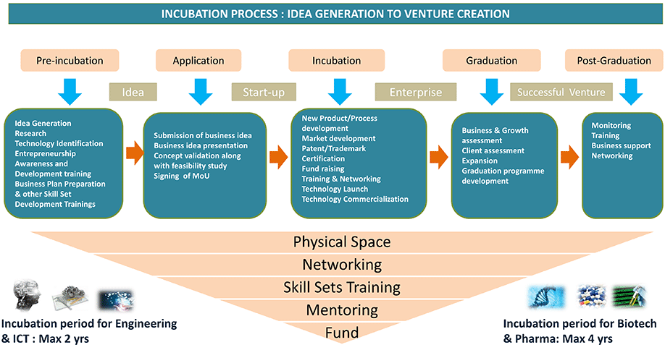
INCUBATION PROCESS
7th April 2015

Slide 17
AGENCIES
STP
Nasscom/CSI
Institutes
Department of MSME
SIDBI
R&D Organization of S&T Department
7th April 2015

Slide 18
WHY ENTREPRENEURSHIP
Advantage
  Ownership
  Freedom
  Creative
  Employer not Employee
Disadvantage
    Risk
Formula for Success
  Risk taking ability
7th April 2015

Slide 19
Thank You !
manaspattnaik@hotmail.com

